Slide 1

.NET Conf
Student Zone

Slide 2
Get started building mobile & desktop apps with .NET
Maddy Montaquila, Senior Product Manager, .NET MAUI @maddymontaquila
Becky Buckler, Product Manager, .NET Growth @bucklerbecky

Slide 3
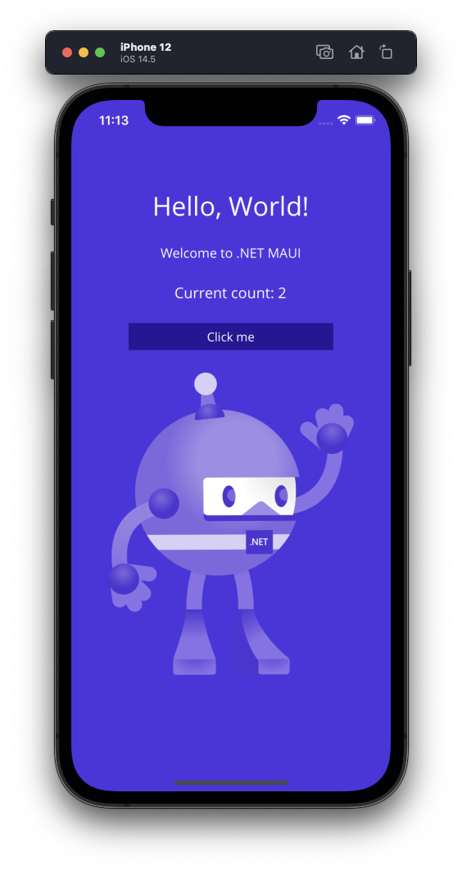
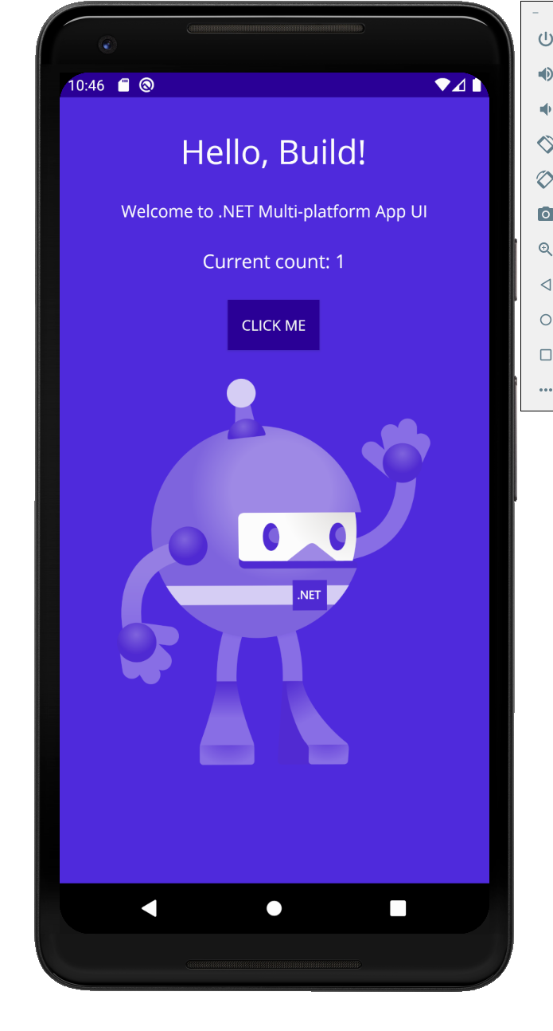
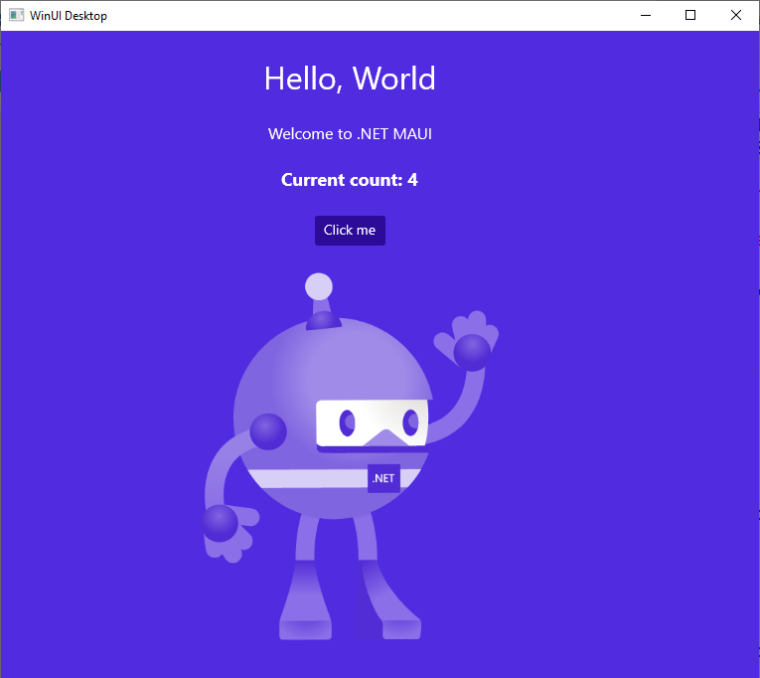
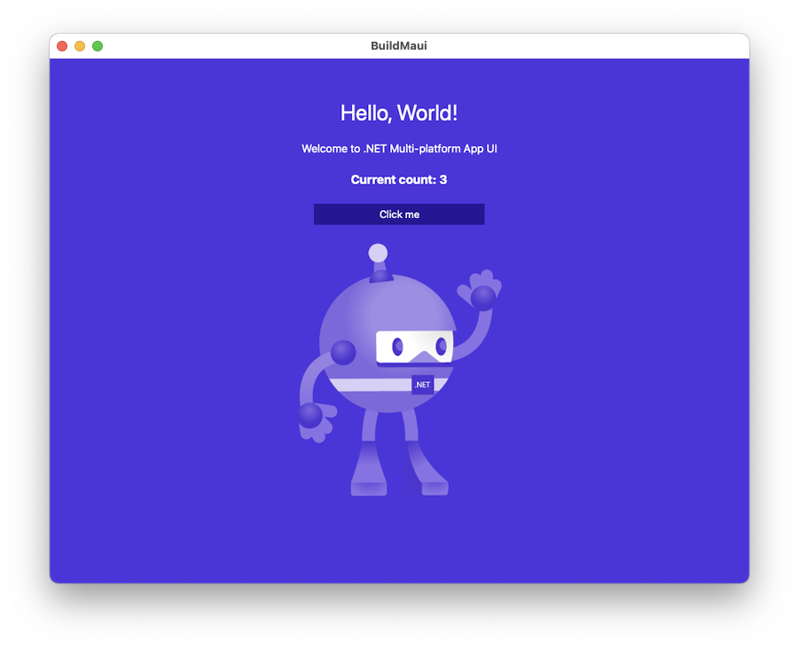
.NET MAUI is the most productive way to develop native apps that perform great on any device that runs Android, iOS, macOS, or Windows from a single codebase.

Slide 4

.NET Multi-platform App UI (MAUI)
Single project system, single codebase
macOS
iOS
WinUI
Mac Catalyst
iOS
Android
Notes:
Damian: .NET MAUI (Multi-platform App UI) is our framework for developers to build native applications across a wide range of platforms. Build from a single C# code base and access native APIs to build world class apps. Over to Maddy to tell us more about what is new in .NET 8.

Slide 5














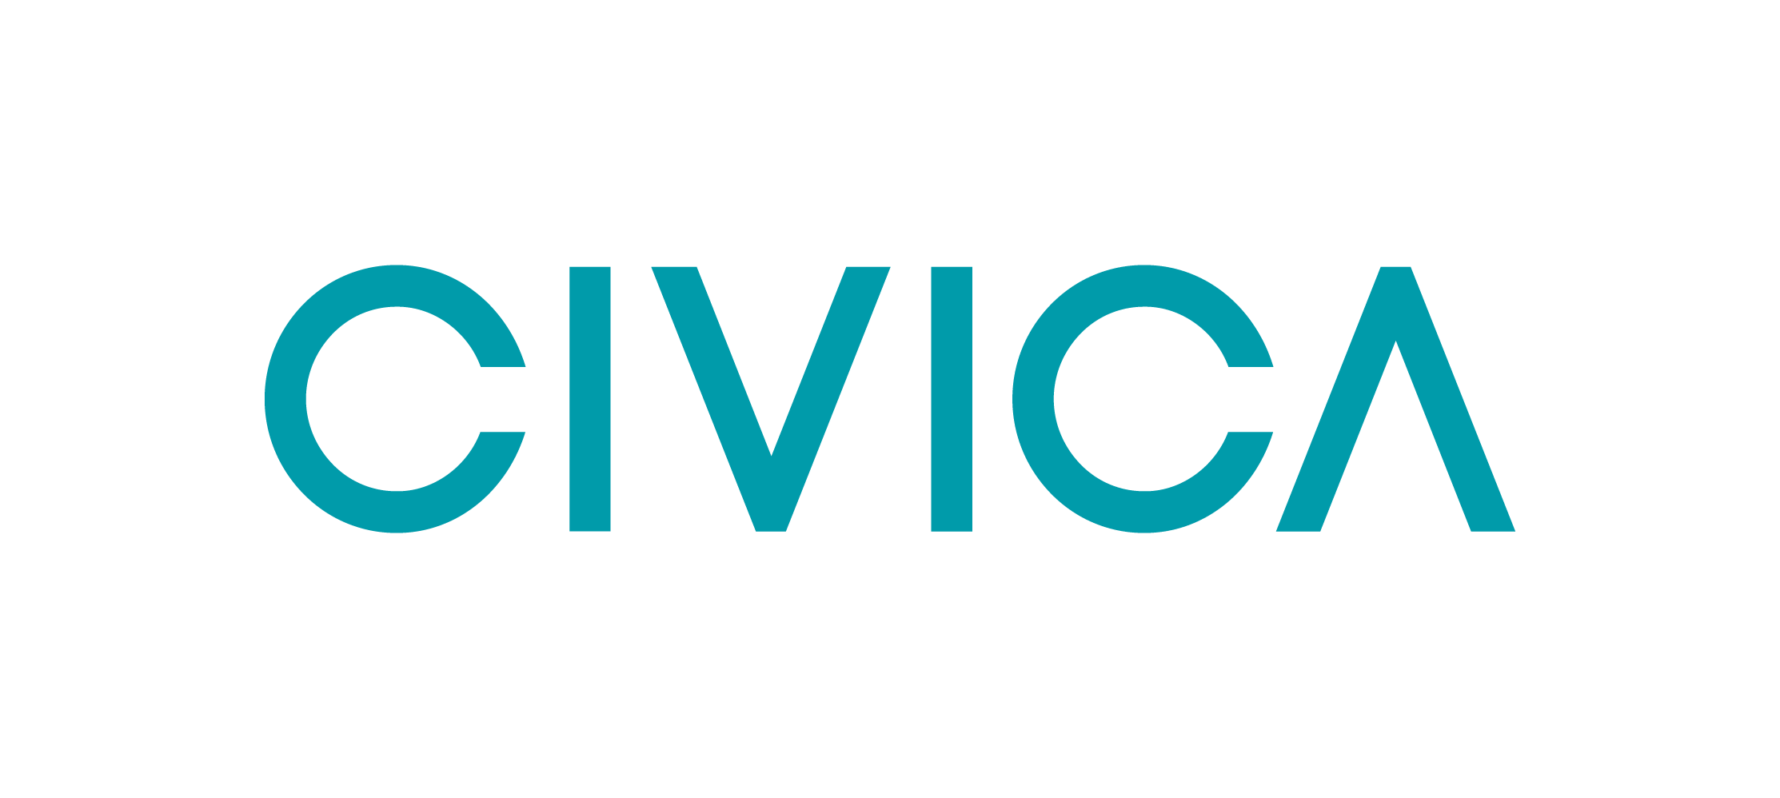













Slide 6









Build anything with a unified platform
.NET
Cloud
Web
Desktop
Mobile
Gaming
IoT
AI
+
+
Visual Studio
Visual Studio Code
CLI
Linux
NuGet
Github
Components, tools, library vendors
Windows
macOS
Tools
Operating system
Ecosystem
Notes:
Our vision for .NET remains the same. Build a unified development platform for developers to build anything with best-in-class runtime, programming languages, development tools, and a vast ecosystem powered by amazing developers around the world.
With .NET, you can build any type of app that you need, for the devices critical to your business, and on the operating system of your choice. .NET will run fantastic anywhere and everywhere you deploy.
Build a website with Blazor and have it talk to a powerful .NET REST API. Take that same API and have it power mobile and desktop apps built with .NET. Infuse your apps with AI or leverage powerful cloud compute and services. .NET is there for you.

Slide 7
Visual Studio 2022 productivity
Intelligent code editing
AI-assisted development
Live Share remote collaboration
C#, XAML, Razor IntelliSense
Rapid iteration
Hot reload XAML, C#, Razor, CSS, and more
Preview and Inspect UI at debug time
Develop for anything, anywhere
Use Android emulators, devices, or WSA
Develop iOS directly from Windows
Use iOS simulators via Xcode
Visual Studio for Mac and Windows
Notes:
James

Slide 8
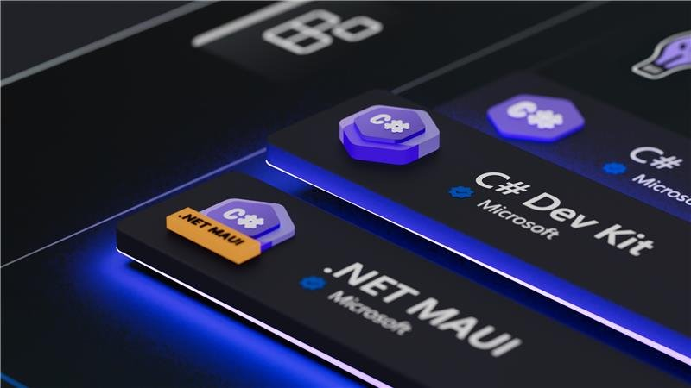
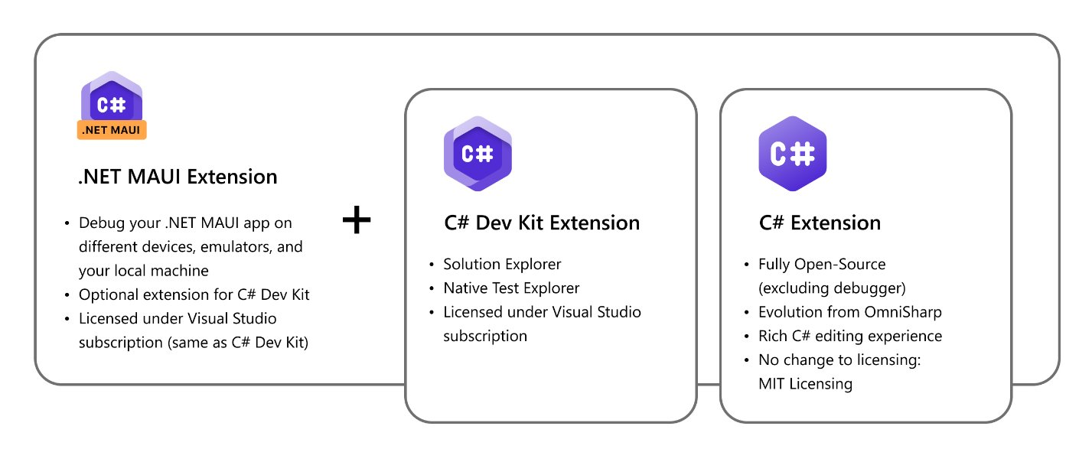
.NET MAUI in VS Code

Slide 9
Coding Time!

Slide 10
More .NET MAUI Resources
https://aka.ms/netconf23/studentrepo
https://learn.microsoft.com/dotnet/maui
https://aka.ms/maui-workshop
https://learn.microsoft.com/training/paths/build-apps-with-dotnet-maui/

Slide 11
Student Zone Repository
https://aka.ms/netconf23/studentrepo
Foundational C# Certification
https://aka.ms/csharp-certification
.NET Beginner Videos
https://aka.ms/dotnetvideos
Watch .NET Conf, November 14-16
https://aka.ms/dotnetconf23-studentzone

Slide 12
Get started building mobile & desktop apps with .NET
Maddy Montaquila, Senior Product Manager, .NET MAUI @maddymontaquila
Becky Buckler, Product Manager, .NET Growth @bucklerbecky

